Slide 1

Department of CSE
Course: AI & ML
Course code: 24AD2001A
Topic:
Clustering: hierarchical, DBSCAN, mean-shift.
Session – 32

Slide 2
Hierarchical CLUSTERING
Hierarchical clustering is an unsupervised learning technique used to group similar data points into clusters by building a hierarchy (tree-like structure). Unlike flat clustering like k-means hierarchical clustering does not require specifying the number of clusters in advance.
Imagine we have four fruits with different weights: an apple (100g), a banana (120g), a cherry (50g) and a grape (30g). Hierarchical clustering starts by treating each fruit as its own group.
Start with each fruit as its own cluster.
Merge the closest items: grape (30g) and cherry (50g) are grouped first.
Next, apple (100g) and banana (120g) are grouped.
Finally, these two clusters merge into one.
Finally all the fruits are merged into one large group, showing how hierarchical clustering progressively combines the most similar data points.

Slide 3
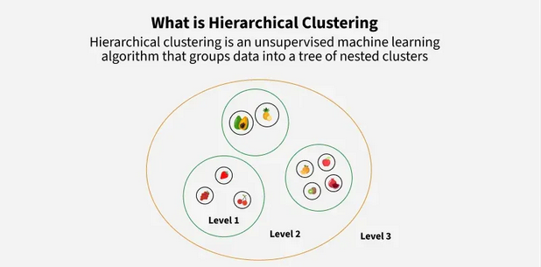
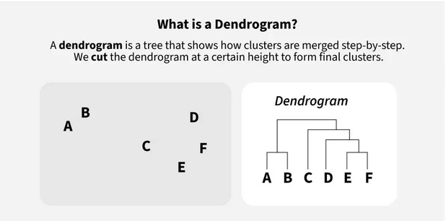
CONTD..

Slide 4
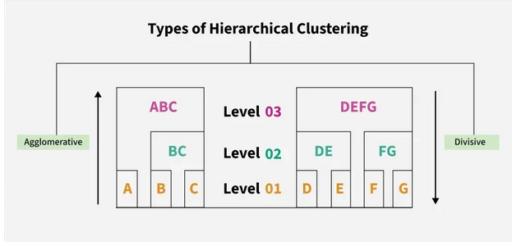
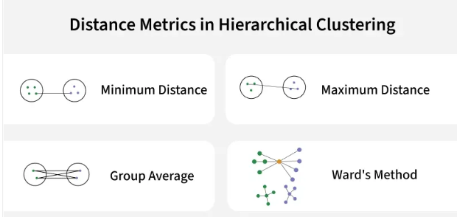
CONTD..

Slide 5
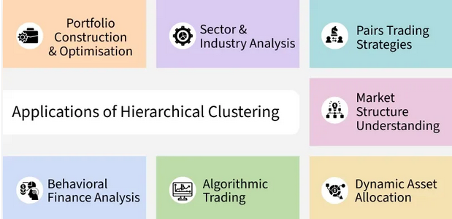
CONTd..

Slide 6
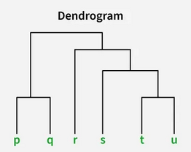
Dendrogram
A dendrogram is like a family tree for clusters. It shows how individual data points or groups of data merge together. The bottom shows each data point as its own group and as we move up, similar groups are combined. The lower the merge point, the more similar the groups are. It helps us see how things are grouped step by step.
>At the bottom of the dendrogram the points P, Q, R, S and T are all separate.
>As we move up, the closest points are merged into a single group.
>The lines connecting the points show how they are progressively merged based on similarity.
>The height at which they are connected shows how similar the points are to each other; the shorter the line the more similar they are

Slide 7
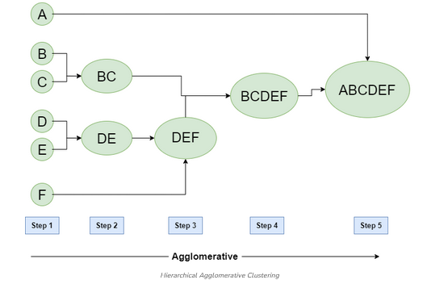
Types of Hierarchical Clustering
Now we understand the basics of hierarchical clustering. There are two main types of hierarchical clustering.
Agglomerative Clustering
Divisive clustering
1. Hierarchical Agglomerative Clustering
It is also known as the bottom-up approach or hierarchical agglomerative clustering (HAC). Bottom-up algorithms treat each data as a singleton cluster at the outset and then successively agglomerate pairs of clusters until all clusters have been merged into a single cluster that contains all data.

Slide 8
Workflow for Hierarchical Agglomerative clustering
Start with individual points: Each data point is its own cluster. For example if we have 5 data points we start with 5 clusters each containing just one data point.
Calculate distances between clusters: Calculate the distance between every pair of clusters. Initially since each cluster has one point this is the distance between the two data points.
Merge the closest clusters: Identify the two clusters with the smallest distance and merge them into a single cluster.
Update distance matrix: After merging we now have one less cluster. Recalculate the distances between the new cluster and the remaining clusters.
Repeat steps 3 and 4: Keep merging the closest clusters and updating the distance matrix until we have only one cluster left.
Create a dendrogram: As the process continues we can visualize the merging of clusters using a tree-like diagram called a dendrogram. It shows the hierarchy of how clusters are merged.

Slide 9
Implementation
Let's see the implementation of Agglomerative Clustering,
Start with each data point as its own cluster.
Compute distances between all clusters.
Merge the two closest clusters based on a linkage method.
Update the distances to reflect the new cluster.
Repeat merging until the desired number of clusters or one cluster remains.
The dendrogram visualizes these merges as a tree, showing cluster relationships and distances.

Slide 10
Computing Distance Matrix
While merging two clusters we check the distance between two every pair of clusters and merge the pair with the least distance/most similarity. But the question is how is that distance determined. There are different ways of defining Inter Cluster distance/similarity. Some of them are:
Min Distance: Find the minimum distance between any two points of the cluster.
Max Distance: Find the maximum distance between any two points of the cluster.
Group Average: Find the average distance between every two points of the clusters.
Ward's Method: The similarity of two clusters is based on the increase in squared error when two clusters are merged.

Slide 11
CONTd.. Also can be called with linkage criteria
The AgglomerativeClustering object performs a hierarchical clustering using a bottom up approach: each observation starts in its own cluster, and clusters are successively merged together. Linkage criteria determine how distances between clusters are calculated during the merging process.The linkage criteria determines the metric used for the merge strategy:
Ward minimizes the sum of squared differences within all clusters. It is a variance-minimizing approach and in this sense is similar to the k-means objective function but tackled with an agglomerative hierarchical approach.
Maximum or complete linkage minimizes the maximum distance between observations of pairs of clusters.
Average linkage minimizes the average of the distances between all observations of pairs of clusters.
Single linkage minimizes the distance between the closest observations of pairs of clusters.

Slide 12
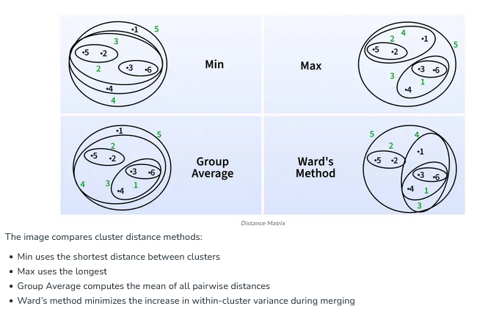
CONTD..

Slide 13
2. Hierarchical Divisive clustering
Divisive clustering is also known as a top-down approach. Top-down clustering requires a method for splitting a cluster that contains the whole data and proceeds by splitting clusters recursively until individual data have been split into singleton clusters.
Workflow for Hierarchical Divisive clustering :
Start with all data points in one cluster: Treat the entire dataset as a single large cluster.
Split the cluster: Divide the cluster into two smaller clusters. The division is typically done by finding the two most dissimilar points in the cluster and using them to separate the data into two parts.
Repeat the process: For each of the new clusters, repeat the splitting process: Choose the cluster with the most dissimilar points and split it again into two smaller clusters.
Stop when each data point is in its own cluster: Continue this process until every data point is its own cluster or the stopping condition (such as a predefined number of clusters) is met.

Slide 14
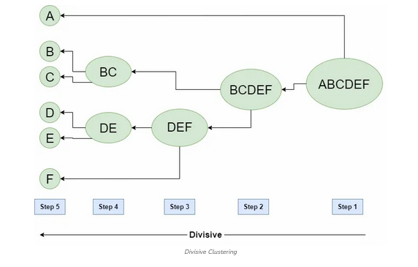
CONTD..

Slide 15
Implementation
Let's see the implementation of Divisive Clustering,
Starts with all data points as one big cluster.
Finds the largest cluster and splits it into two using KMeans.
Repeats splitting the largest cluster until reaching the desired number of clusters.
Assigns cluster labels to each data point based on the splits.
Returns history of clusters at each step and final labels.
Visualizes data points colored by their final cluster.

Slide 16
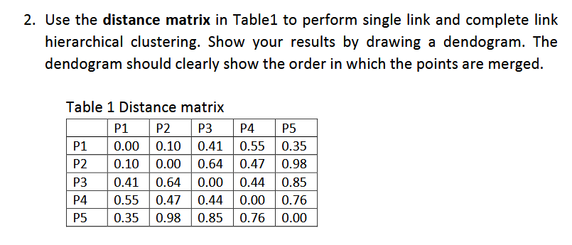
Problem with solution: AGGLOMERATIVE HIERARCHICAL clustering

Slide 17
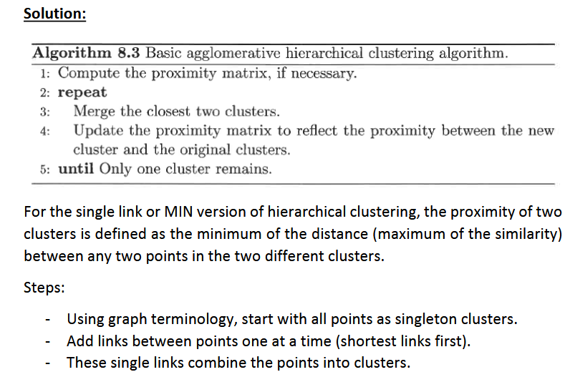
CONTD..

Slide 18
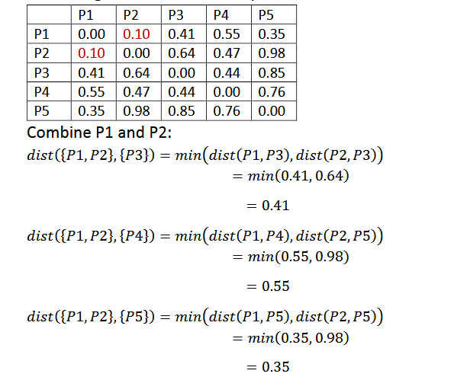
CONTD..

Slide 19
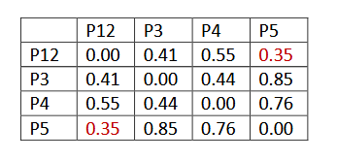
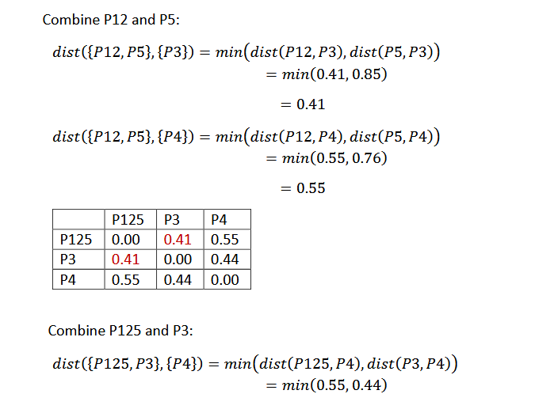

Slide 20
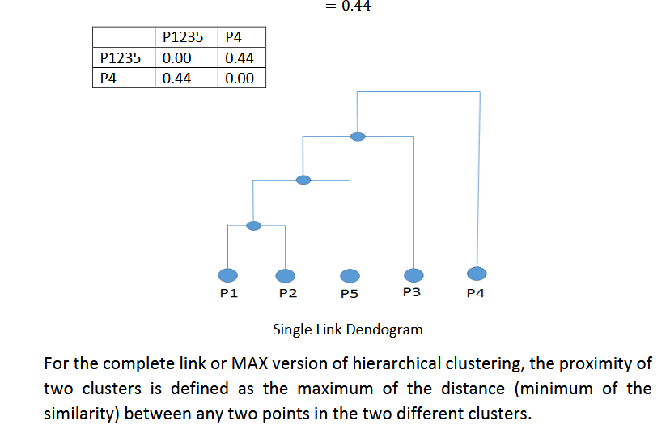

Slide 21
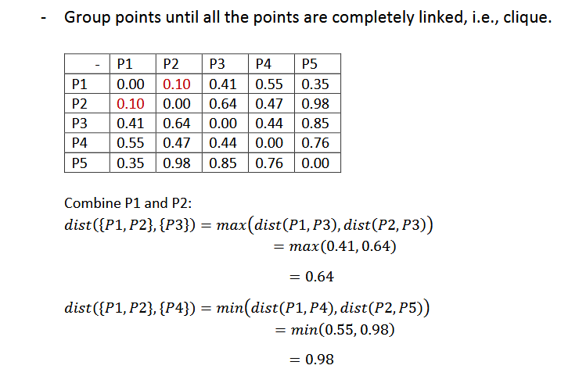
Steps:
- Using graph terminology, start with all points as singleton clusters.
- Add links between points one at a time (shortest links first).

Slide 22
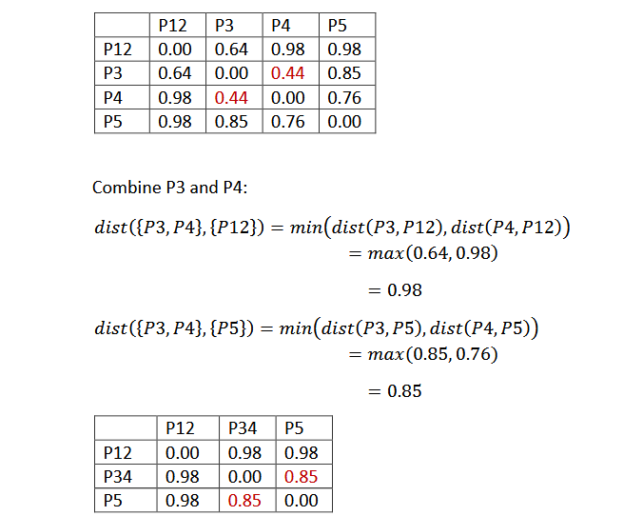
CONTD..

Slide 23
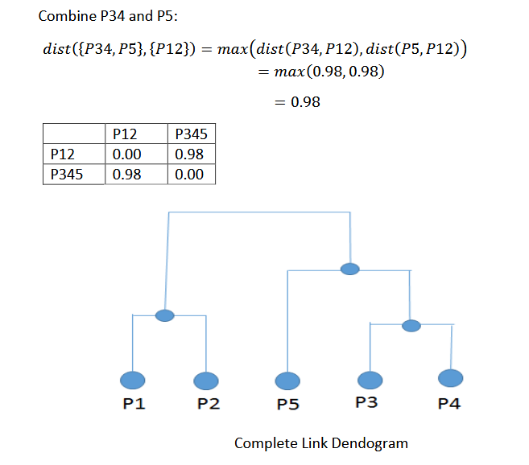

Slide 24
DBSCAN Clustering
DBSCAN is a density-based clustering algorithm that groups data points that are closely packed together and marks outliers as noise based on their density in the feature space. It identifies clusters as dense regions in the data space separated by areas of lower density. Unlike K-Means or hierarchical clustering which assumes clusters are compact and spherical, DBSCAN perform well in handling real-world data irregularities such as:
Arbitrary-Shaped Clusters: Clusters can take any shape not just circular or convex.
Noise and Outliers: It effectively identifies and handles noise points without assigning them to any cluster.
The figure below shows a data set with clustering algorithms: K-Means and Hierarchical handling compact, spherical clusters with varying noise tolerance while DBSCAN manages arbitrary-shaped clusters and noise handling.

Slide 25
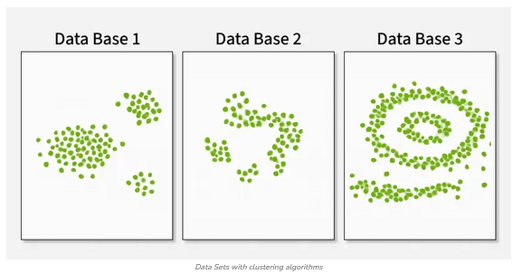
CONTD..

Slide 26
DBSCAN
The algorithm works by defining clusters as dense regions separated by regions of lower density. This approach allows DBSCAN to discover clusters of arbitrary shape and identify outliers as noise.
DBSCAN revolves around three key concepts:
Core Points: These are points that have at least a minimum number of other points (MinPts) within a specified distance (ε or epsilon).
Border Points: These are points that are within the ε distance of a core point but don't have MinPts neighbors themselves.
Noise Points: These are points that are neither core points nor border points. They're not close enough to any cluster to be included.

Slide 27
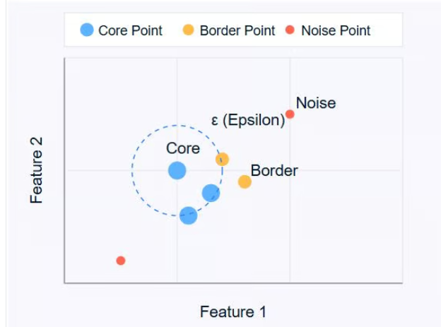
CONTD..

Slide 28
CONTD..
The diagram above illustrates these concepts. Core points (blue) form the heart of clusters, border points (orange) are on the edge of clusters, and noise points (red) are isolated.
DBSCAN uses two main parameters:
ε (epsilon): The maximum distance between two points for them to be considered as neighbors.
MinPts: The minimum number of points required to form a dense region.
By adjusting these parameters, you can control how the algorithm defines clusters, allowing it to adapt to different types of datasets and clustering requirements.

Slide 29
How Does DBSCAN Work?
DBSCAN operates by examining the neighborhood of each point in the dataset. The algorithm follows a step-by-step process to identify clusters based on the density of data points. Let's break down how DBSCAN works:
1. Parameter Selection
  Choose ε (epsilon): The maximum distance between two points for them to be considered as neighbors.
  Choose MinPts: The minimum number of points required to form a dense region.
2. Select a Starting Point
  The algorithm starts with an arbitrary unvisited point in the dataset.

Slide 30
CONTD..
3. Examine the Neighborhood It retrieves all points within the ε distance of the starting point.
If the number of neighboring points is less than MinPts, the point is labeled as noise (for now).
If there are at least MinPts points within ε distance, the point is marked as a core point, and a new cluster is formed.
4. Expand the Cluster All the neighbors of the core point are added to the cluster.
For each of these neighbors:
  If it's a core point, its neighbors are added to the cluster recursively.
  If it's not a core point, it's marked as a border point, and the expansion stops.

Slide 31
CONTD..
5. Repeat the Process The algorithm moves to the next unvisited point in the dataset.
Steps 3-4 are repeated until all points have been visited.
6. Finalize Clusters After all points have been processed, the algorithm identifies all clusters.
Points initially labeled as noise might now be border points if they're within ε distance of a core point.
7. Handling Noise Any points not belonging to any cluster remain classified as noise.
This process allows DBSCAN to form clusters of arbitrary shapes and identify outliers effectively. The algorithm's ability to find clusters without specifying the number of clusters beforehand is one of its key strengths. It's important to note that the choice of ε and MinPts can significantly affect the clustering results.

Slide 32
DBSCAN Key Concepts and Parameters
To fully grasp how DBSCAN forms clusters, it's important to understand two key concepts: density reachability and density connectivity.
Density reachability
A point q is density-reachable from a point p if:
1. p is a core point (has at least MinPts within ε distance)
2. There is a chain of points p = p₁, ..., p_{n} = q where each p_{i}+1 is directly density-reachable from p_{i.}
In simpler terms, you can reach q from p by stepping through core points, where each step is no larger than ε.

Slide 33
CONTD..
Density connectivity
Two points p and q are density-connected if there exists a point o such that both p and q are density-reachable from o.
Density connectivity is the basis for forming clusters in DBSCAN. All points in a cluster are mutually density-connected, and if a point is density-connected to any point in the cluster, it also belongs to that cluster.
Choosing DBSCAN Parameters
The effectiveness of DBSCAN heavily depends on the choice of its two main parameters: ε (epsilon) and MinPts. Here's how to approach selecting these parameters:

Slide 34
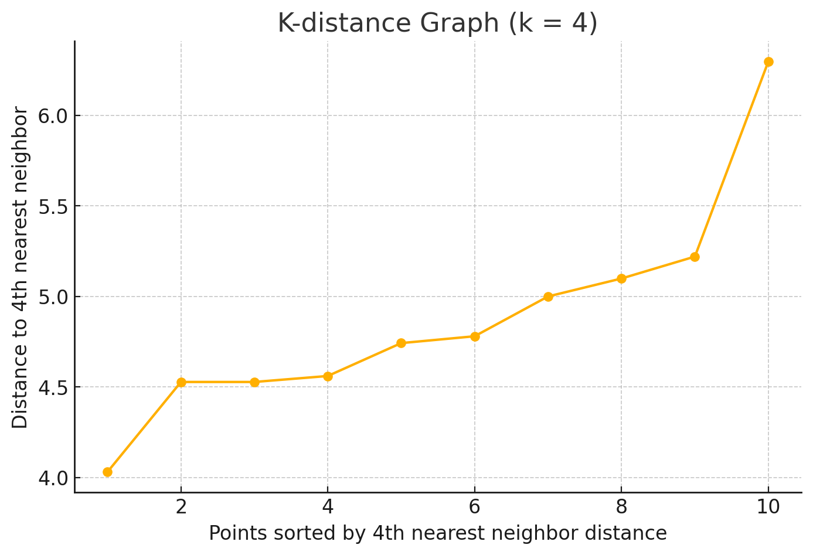

Slide 35
CONTD..
Selecting ε (Epsilon)
The ε parameter determines the maximum distance between two points for them to be considered neighbors. To choose an appropriate ε:
1. Use domain knowledge: If you have insight into what distance is meaningful for your specific problem, use that as a starting point.
2. K-distance graph: This is a more systematic approach:
Calculate the distance to the k-th nearest neighbor for each point (where k = MinPts).
Plot these k-distances in ascending order.
Look for an "elbow" in the graph – a point where the curve starts to level off.
The ε value at this elbow is often a good choice.

Slide 36
CONTD..
Selecting MinPts
MinPts determines the minimum number of points required to form a dense region. Here are some guidelines:
1. General rule: A good starting point is to set MinPts = 2 * num_features, where num_features is the number of dimensions in your dataset.
2. Noise consideration: If your data has noise or you want to detect smaller clusters, you might want to decrease MinPts.
3. Dataset size: For larger datasets, you might need to increase MinPts to avoid creating too many small clusters.
Remember, the choice of parameters can significantly affect the results. It's often beneficial to experiment with different values and evaluate the resulting clusters to find the best fit for your specific dataset and problem.

Slide 37
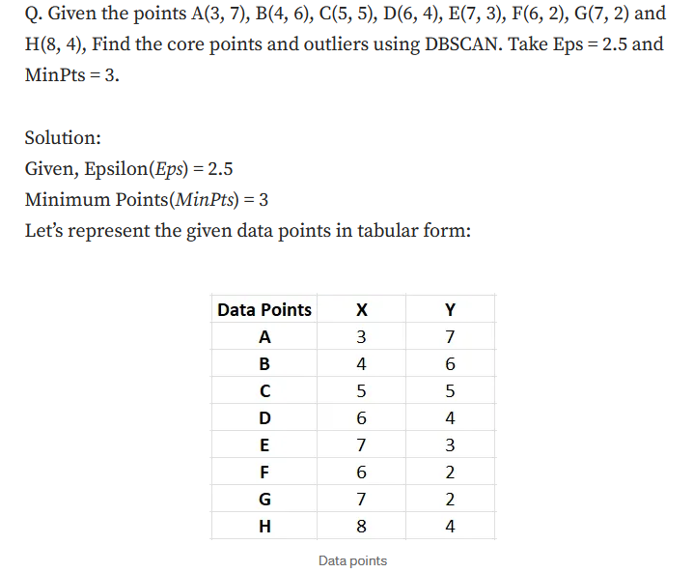
Problem with solution

Slide 38
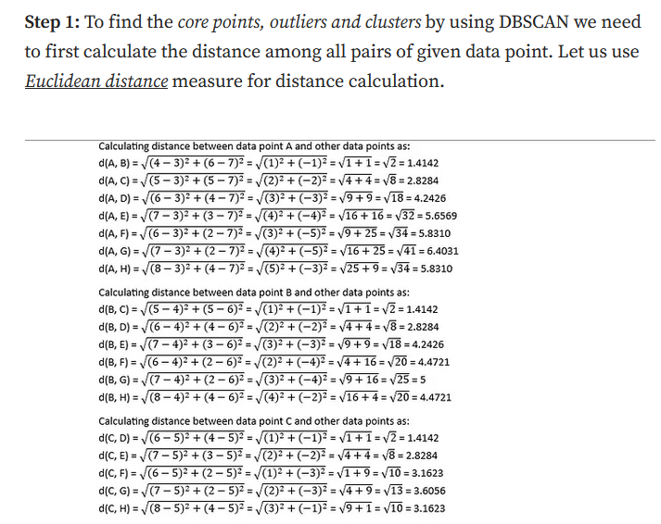

Slide 39
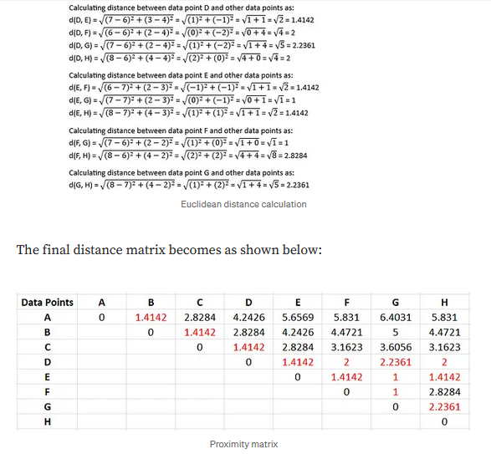

Slide 40
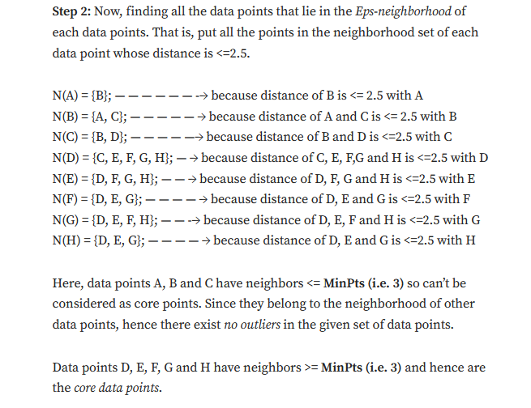
The diagonal elements of this matrix will always be 0 as the distance of a point with itself is always 0. In the above table, Distance ≤ Epsilon (i.e. 2.5) is marked red.

Slide 41
Mean-Shift Clustering
Mean shift clustering is used to identify clusters in datasets where the number of clusters is not known beforehand. It finds clusters by iteratively shifting data points toward the densest regions in the feature space. This makes it particularly useful for applications such as object recognition, where it can segment images based on pixel intensity and color, and also for tracking objects in video sequences.
As a mode-seeking algorithm, it labels the clusters by finding the modes, or peaks, in the data distribution. Essentially, it highlights the most dense areas. It does this by iteratively shifting the cluster centers toward regions of a higher data density. Here are the steps:

Slide 42
Mean-Shift Clustering
Initialization: Start by considering each data point as a potential candidate for the cluster center.
Density Estimation: For each data point, define a window around it, called the radius, and then compute the mean of those data points within this radius.
Shifting: Shift each point to this mean position. This step moves the point towards the region of higher density.
Convergence: Repeat steps 2 and 3 iteratively until convergence, i.e., when the shift is smaller than a predefined threshold. The insignificant change in shift implies that the points have stabilized around the local maxima of the density function.

Slide 43
Why Use Mean Shift Clustering?
Mean shift clustering is a powerful tool for uncovering the underlying structure of data without making any assumptions about its parameters such as the number of clusters or their shape. Considering its density-based approach that focuses on regions of high data density, it is robust against outliers, thereby ensuring that noisy data has minimal impact on the clustering process. Such robustness makes it an apt fit for real-world datasets, which often contain irregularities and noise, and also for applications requiring adaptability and precision.
Some of the real-world scenarios where mean shift clustering works well are:

Slide 44
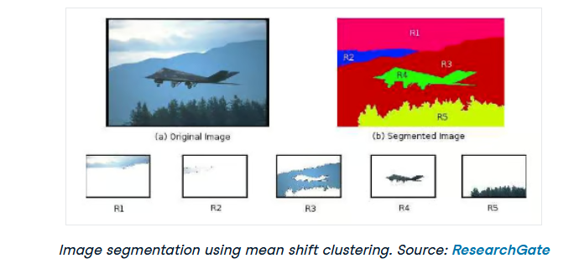
1. EX: Image segmentation
The mean shift clustering algorithm can segment images into regions based on pixel intensity or color without requiring prior knowledge of the number of segments. This flexibility makes it highly effective for image segmentation tasks because the clusters generated using mean shift clustering can take any shape or size.

Slide 45
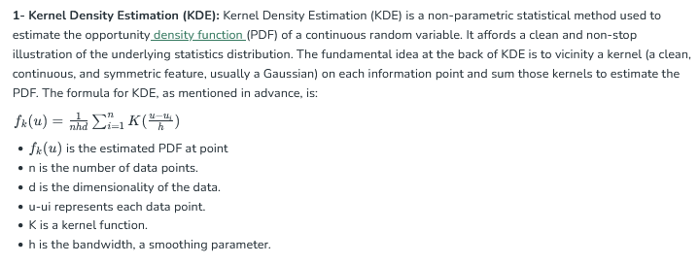
Key Concepts of Mean-Shift Clustering

Slide 46
CONTD..
2- Choosing the Right Bandwidth/Radius: The desire of bandwidth (h) in Mean Shift and KDE is crucial as it notably affects the smoothness and accuracy of the predicted PDF.
There are a number of different ways to select the bandwidth for Mean Shift clustering. Some common approaches include:
Scott's Rule: This rule selects a bandwidth that is proportional to the standard deviation of the data.
Silverman's Rule: This rule selects a bandwidth that is proportional to the median interquartile range of the data.
Cross-validation: This approach involves training Mean Shift clustering with a range of different bandwidth values and evaluating the performance of the algorithm on a held-out test set. The bandwidth that results in the best performance on the test set is then selected.
Expert Knowledge: If you have got domain-specific information or earlier records approximately your statistics, you can pick the bandwidth manually. Adjusting the bandwidth based totally in your know-how of the facts's traits can from time to time result in better results.

Slide 47
CONTD..
The need of bandwidth is to get stability between over-smoothing and underneath-smoothing (sensitive to noise). It frequently depends at the unique traits of your records, and experimentation may be required to locate the most appropriate bandwidth on your clustering or density estimation challenge.
3- Convergence: Convergence in Mean Shift occurs when the data points stop moving significantly. This means that the data points have reached the modes of the density distribution and are no longer moving towards higher density regions.
4- Bandwidth Kernel Function: The bandwidth kernel function is a function that is used to weight the data points when calculating the mean shift vector. It controls the size of the window around each data point that Mean Shift uses to calculate the mean shift vector. A larger bandwidth will result in fewer clusters, while a smaller bandwidth will result in more clusters.
5- Mean shift vector: The mean shift vector for a data point points in the direction of the highest density of data points around it. Mean Shift moves the data points in the direction of their mean shift vectors, which ultimately leads to the data points converging to the modes of the density distribution.

Slide 48
How mean-shift works?
Mean Shift operates through a series of steps to identify clusters within a dataset
Kernel Density Estimation: It begins with estimating the PDF of the facts the usage of kernel density estimation. A kernel feature is used to symbolize the distribution of statistics points in the function space. A common desire is the Gaussian kernel. This step helps in figuring out areas of excessive records density.
Mean Shift Vector: For every statistics point, Mean Shift calculates a median shift vector that points towards the mode (peak) of the anticipated PDF. This vector represents the direction wherein the records point need to pass to reach a location of higher density.
Shifting Data Points: Data factors are shifted within the path of their respective mean shift vectors. This step is executed iteratively, and the records points steadily circulate towards the nearest modes (cluster centers) inside the feature space.
Convergence: The technique keeps until information factors now not pass significantly, indicating convergence. A convergence threshold can be defined to manipulate when to forestall the iterations.
Cluster Assignment: Once convergence is accomplished, statistics factors are assigned to their nearest modes, effectively growing clusters.
Mean Shift correctly identifies clusters via iteratively moving information points closer to regions of higher density until they attain modes, which represent the cluster facilities.

Slide 49
Algorithm
The Mean Shift Algorithm follows a specific sequence of operations to move statistics factors closer to the modes of the anticipated density. The steps involved are as follows:
Initialization: Start with hard and fast data points.
Bandwidth Selection: Choose the ideal bandwidth h for the kernel. You can use techniques like Scott's Rule or Silverman's Rule or estimate it using move-validation.
Mean Shift Computation: For each data point, compute the mean shift vector M(x).
Shift Data Points: Update the data points by shifting them in the direction of M(x). x←x+M(x).
Convergence Check: Repeat steps three and four until the data points do not converge. You can outline a convergence threshold.
Cluster Assignment: Once the data factors have converged, assign every point to its nearest mode (cluster middle).
Result: The final clusters are determined based on the modes.
The Mean Shift set of rules iteratively refines the positions of statistics points, moving them toward the modes of the estimated density.

Slide 50
THANK YOU
Team – AI &ML

